Slide 1
2013 INBRE Project
Subaward Management
Barbara Bunge
MSU Subaward Manager
(406) 994-2381
bbunge@montana.edu

Slide 2
Subaward
Rules and Regulations
SUBRECIPIENT agrees to comply with all requirements and provisions of the prime award relevant to subcontractors.
National Institute of Health (NIH) project:
NIH Grants Policy Statement – online
Subaward Agreement
OMB Circulars
Recipient’s internal/external policies
Notes:
Seems like a lot of rules doesn’t it?

Slide 3


Way too many rules!
Rules!!
More Rules!!

Slide 4
Circulars / Regulations
Govern how federal funds / awards are spent
Relevant Circulars are:
  A-133 Single Audit
        “Audit of states expending federal awards”
  A-110 Administrative Requirements
        “For grants & agreements with institution of higher ed”
  A-87 Principles for Determining Costs
        “for State, Local, and Indian Tribal Governments”
  A-21 Principles for Determining Costs
        “for Educational Institutions”
        Allowable, Reasonable, Allocable
Copies of all OMB Circulars can be found at the following web site: www.whitehouse.gov/WH/EOP/OMB
Notes:
Allocable means: Whole expense on the grant or parts
OMB = Office of Management & Budget

Slide 5
Factors affecting allowability of costs.
From A-21 and A-87
Allowable
Reasonable: Prudent person test
Necessary
Institutional policies and practices
Allocable – specific to grant project
Consistent treatment
We’ve always done it!
More video ☺
Notes:
Reasonable: laptop cover from Sax 5th Avenue
Consistently treated: laptops used by multiple projects, usually reported in your F&A negotiations as part of the A pool.
“Always charged” isn’t a good explanation.

Slide 6
Unallowable & Sensitive Costs
Unallowable
Alcoholic Beverages
Entertainment or Social Costs including non-travel meals
Fines & Penalties
General Purpose Equipment
Supplies or equipment for personal use
Sensitive
Memberships, subscriptions & professional activity costs
Travel, especially foreign
Advertising
Equipment
Add’l compensation, typically not allowed on a federally funded award
General Office Supplies/furniture
BUT, there are exceptions with every type of cost…
More video ☺
Notes:
Define additional compensation: A-21 “Charges for work performed on sponsored agreements will be based on the individual faculty member’s regular compensation.”

Slide 7
Compliance & Fiscal Management
Fiscal Management
“If not for the grant, would I have this expense?”
Accounting records & expenditures need to match
Sponsor approved budget
Cost Transfers
Compliance
Failure to comply jeopardizes future funding at MSU or the PI
May need to repay unallowable costs
Disciplinary action/criminal charges
Direct questions to MSU when in doubt (406-994-2381)
Notes:
Things to consider when making your decisions.
Department & PI know the financial details OSP provides oversight
Compliance refers to what the agreement says

Slide 8
Total Project Cost
Salaries & Wages / Benefits
Contracted Services
Supplies
Travel
Tuition
Direct Cost
Refer to agreement budget
+ Indirect Costs at
Federally Negotiated Rate
May include but not limited to:
  Not readily identified with a particular grant
  Office furniture / office supplies
  Utilities, space costs;
  Financial record keeping;
  Project management;
Notes:
Indirect costs represent the expenses of doing business that are not readily identified with a particular grant, contract, project function or activity, but are necessary for the general operation of the organization and the conduct of activities it performs. In theory, costs like heat, light, accounting and personnel might be charged directly if little meters could record minutes in a cross-cutting manner. Practical difficulties preclude such an approach. Therefore, cost allocation plans or indirect cost rates are used to distribute those costs to benefiting revenue sources.

Slide 9
MSU Invoice Review
Documentation: Is there documentation to support the cost or activity? Examples of documentation include:
Vendor Purchase orders
Invoices / Receipts
Does the documentation demonstrate the:
Reason for selecting vendor (especially if sole-sourced)
Total amount of charge
Meaningful justification for charge (business purpose)
Appropriate levels of review and/or approval – i.e. institutional requisition form

Slide 10
Cost Share
Federal regulations require that cost sharing be:
Verifiable
Allowable
Incurred during the period of the award
Not from other Federally-funded sources
Cost sharing for awards should be separately tracked and reported

Slide 11
Changes
Prior approval required:
Changes in the amounts of budget categories, i.e. travel, salaries etc.
Equipment not in approved budget
Inclusion of costs requiring prior approval in OMB Cost Principles
Extended absence, or change of Principal Investigator or other key personnel
Changes to Scope of Work
No-cost extension – won’t be allowed because of NIH award regulations

Slide 12
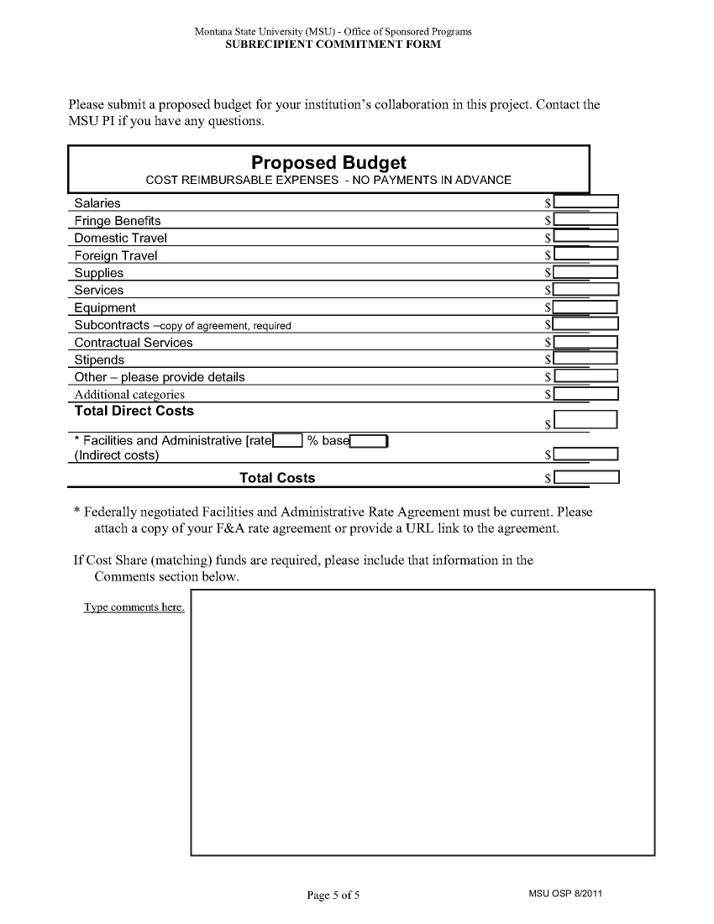
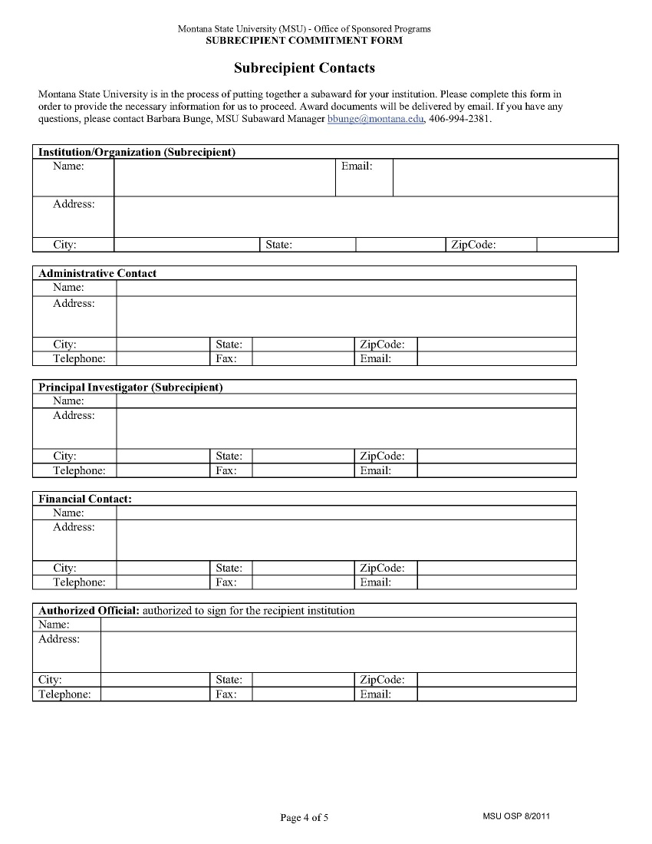
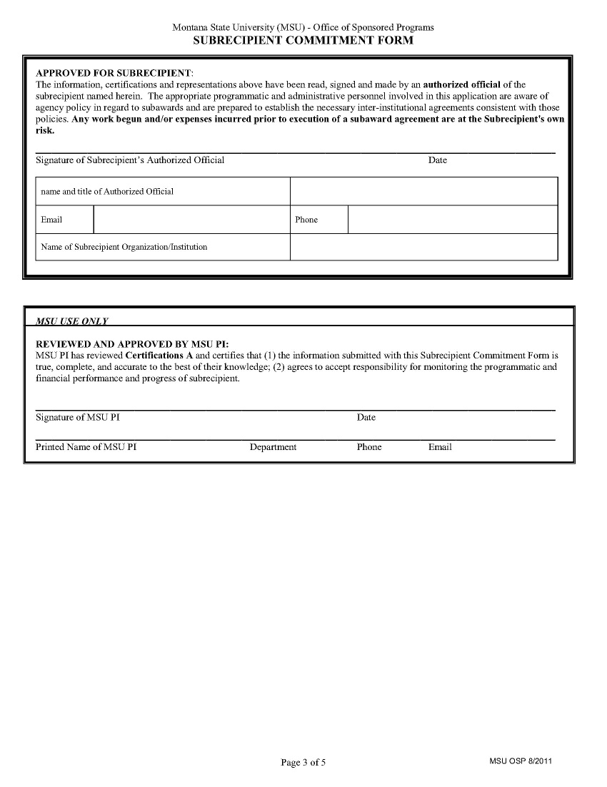
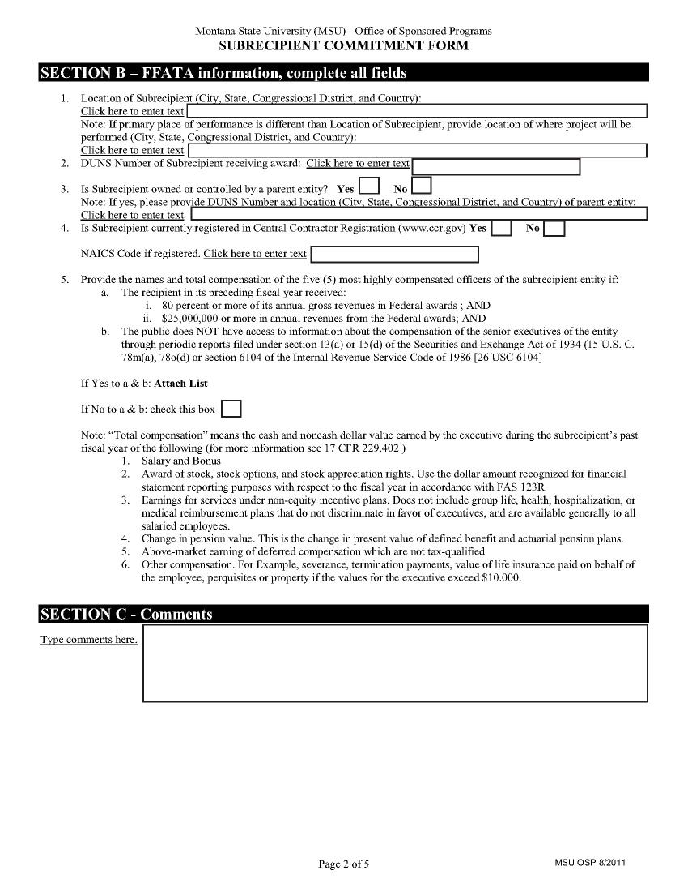
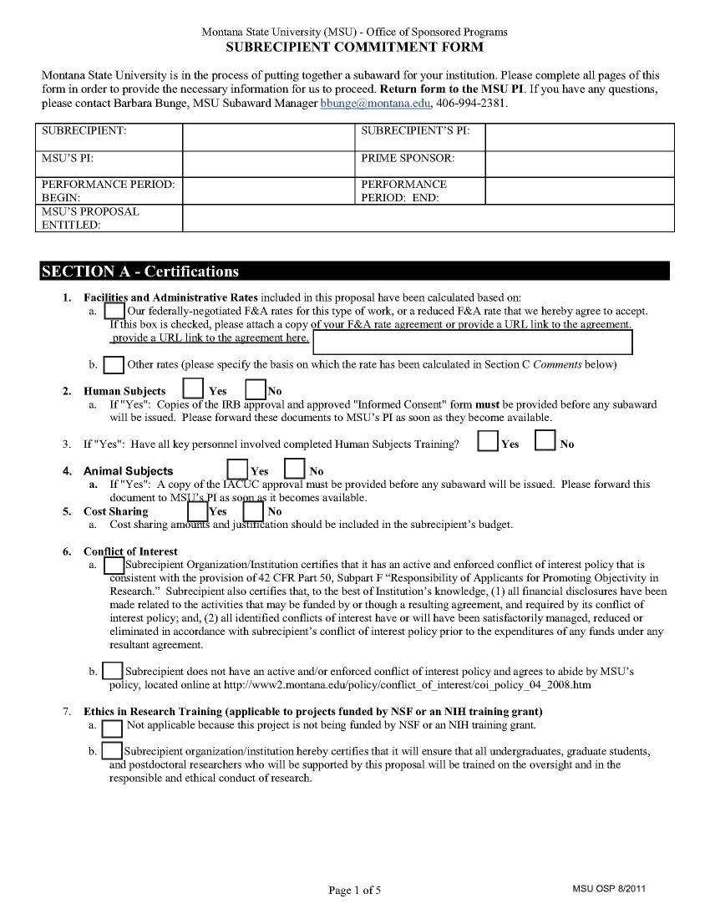
Subrecipient Commitment Form
Complete all, sign, return to Laurie

Slide 13
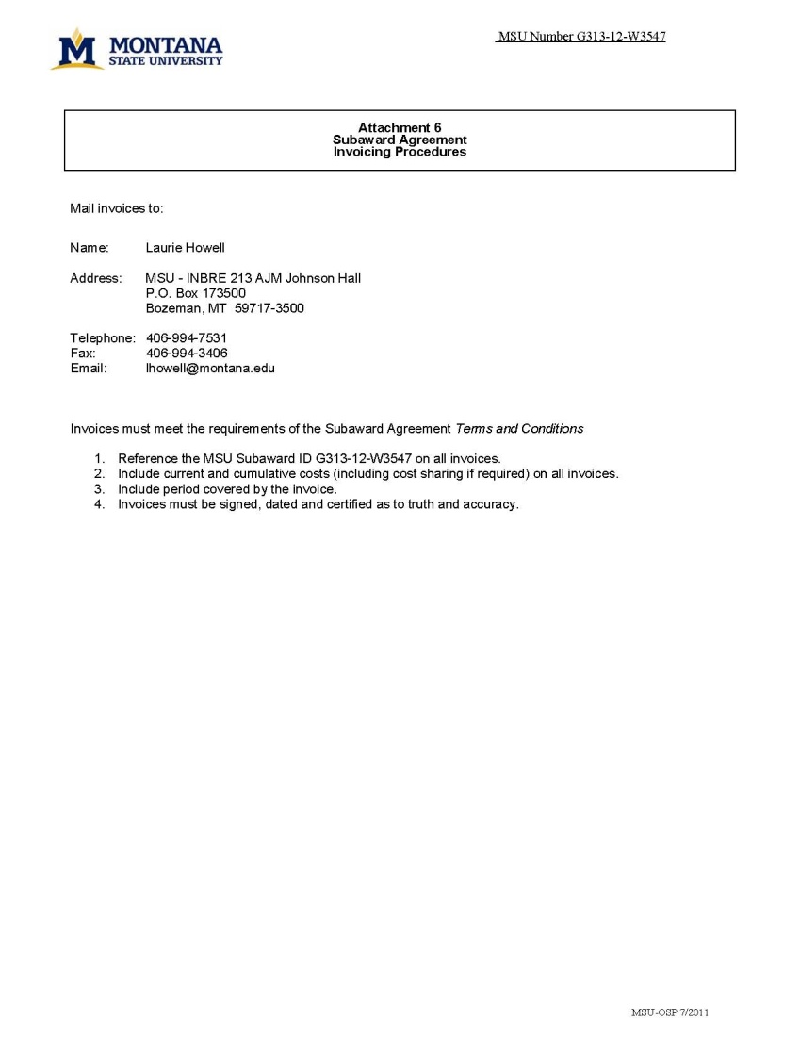
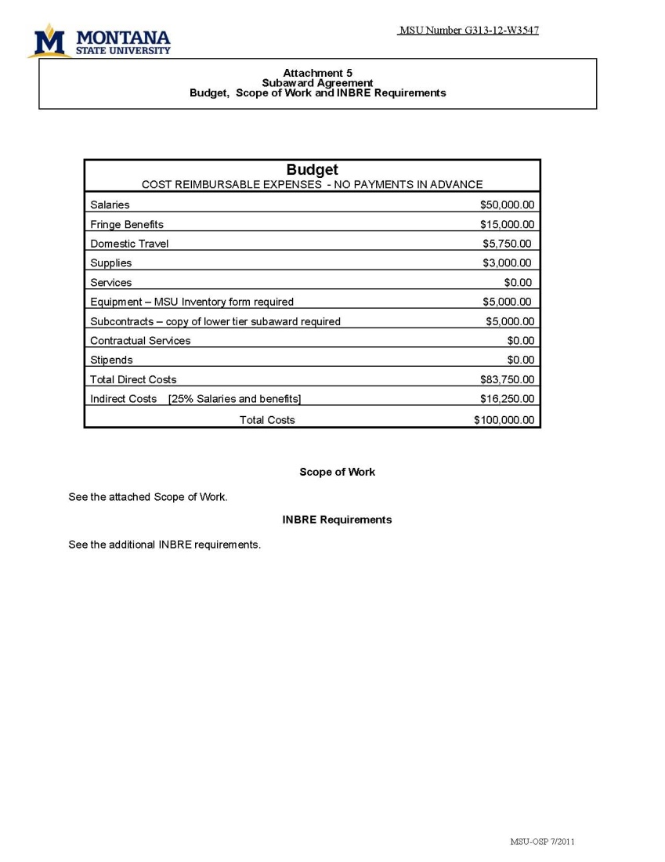
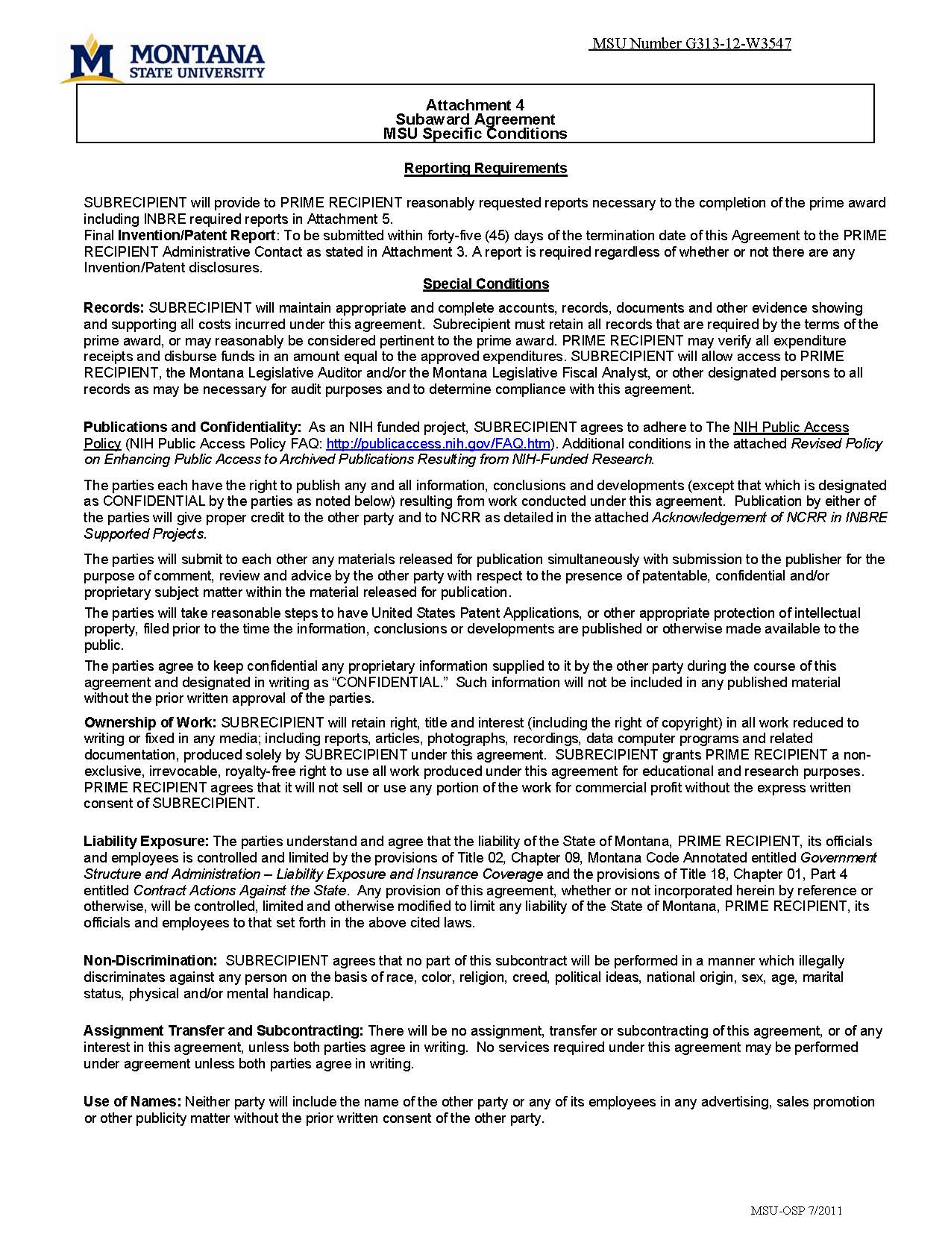
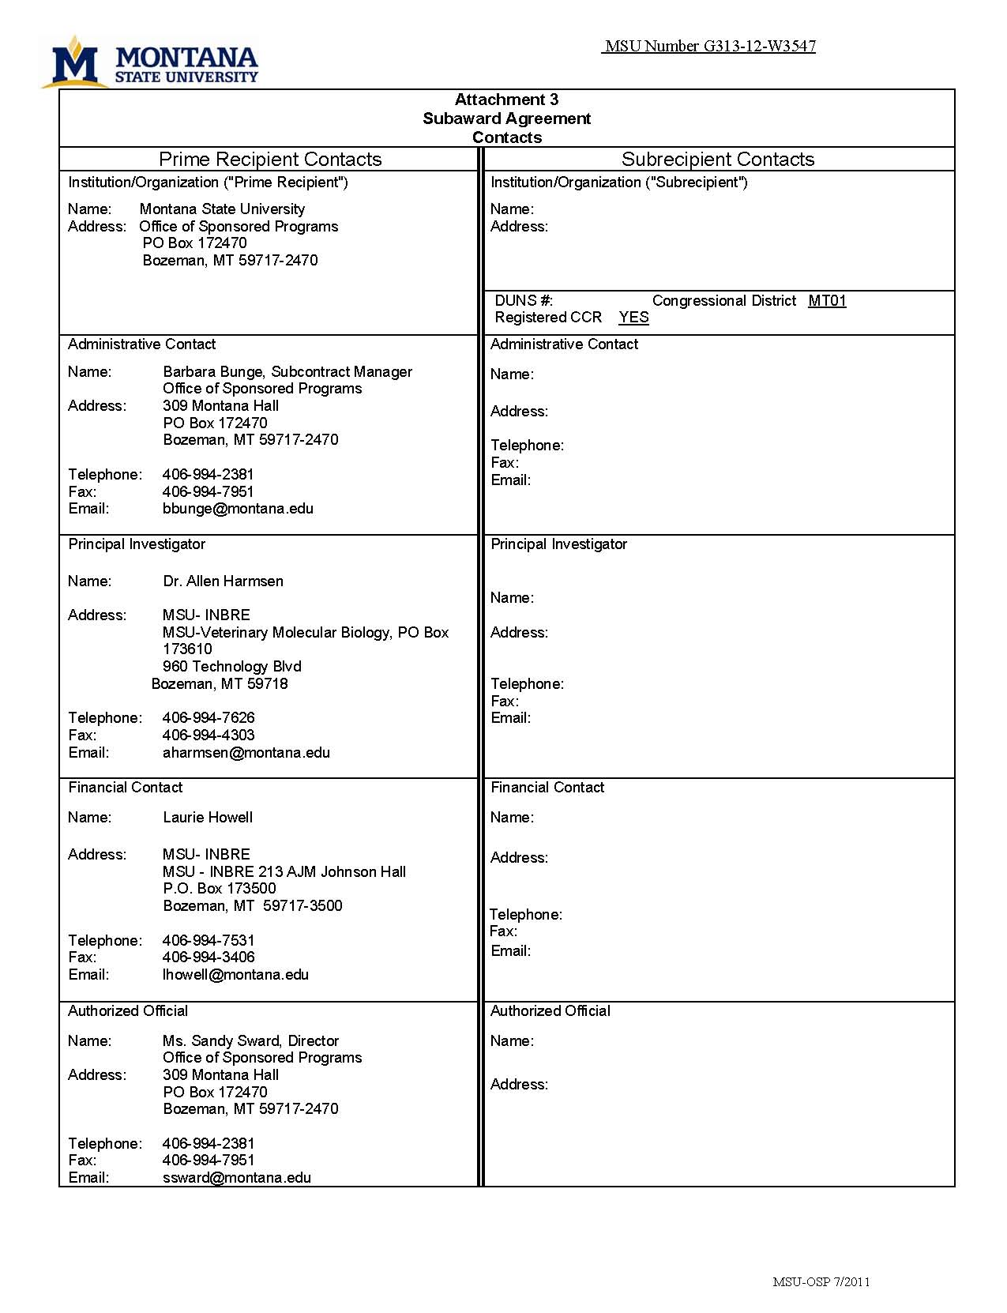

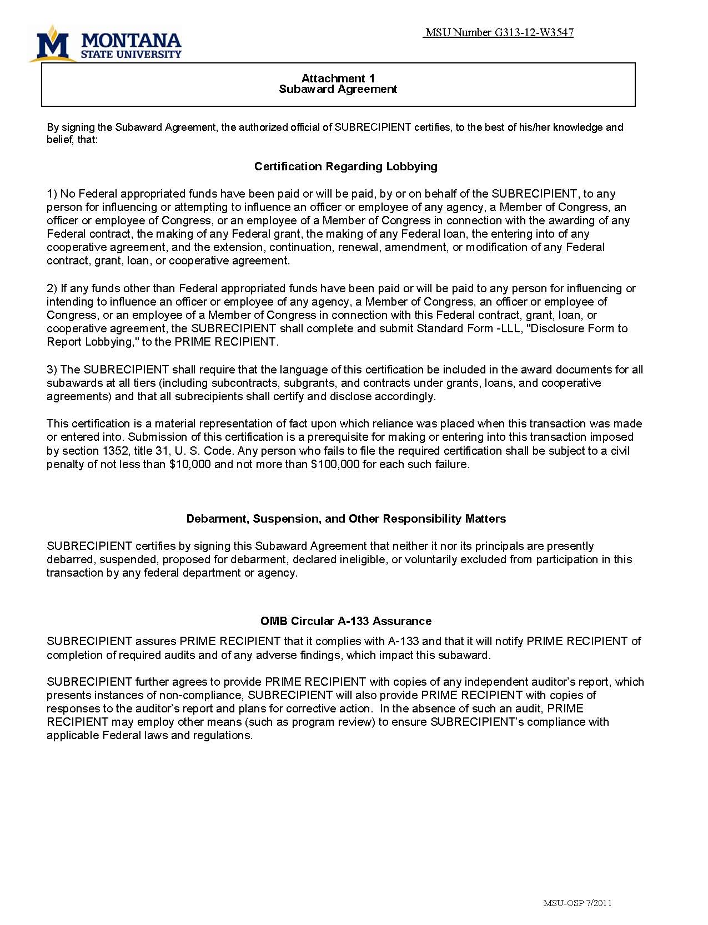
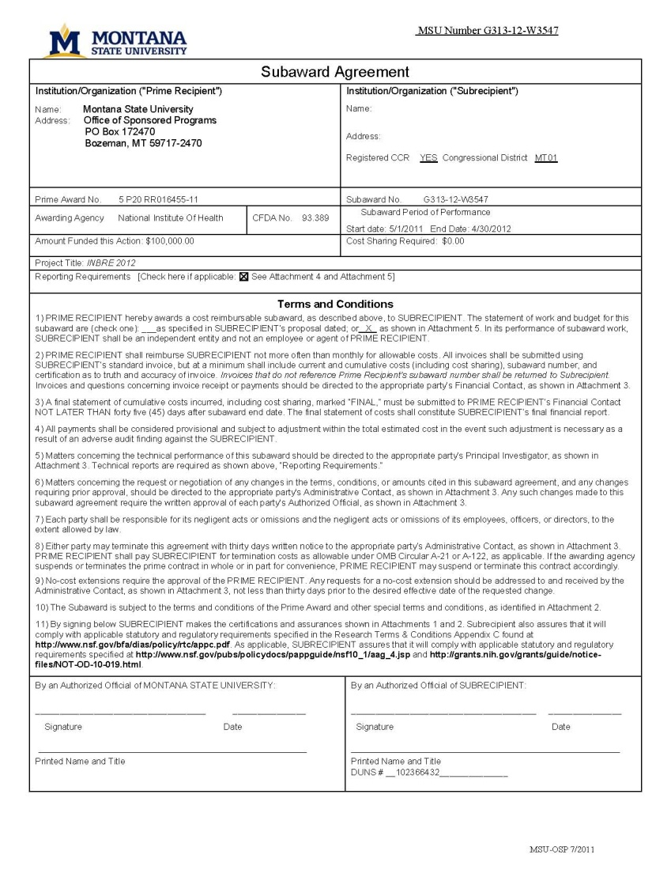
Subaward Agreement
update
Notes:
Example of file: tab important pages. Bring sample file.

Slide 14
Subrecipient Invoice
Within award period
Scope of work
Final invoice due 45 days after end date
Sign, date, subcontract ID
Include cumulative by category
No overspending
Notes:
Reconcile with invoice with your financial reports
Expect to provide backup on at least one invoice.

Slide 15
Equipment
Required for any equipment purchases over $5,000 (OMB A-110). See NSF Research Terms and Conditions: net invoice price of the equipment, including the cost of modifications, attachments, accessories, or auxiliary apparatus necessary to make the property usable for the purpose for which it was acquired. http://www.nsf.gov/publications/pub_summ.jsp?ods_key=rtc

Slide 16
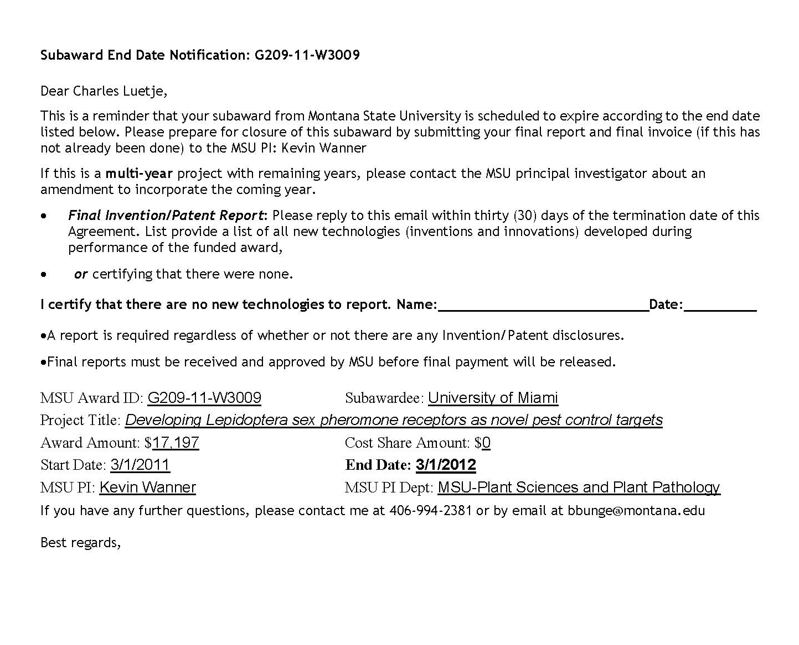
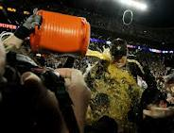
End Date Notification – sign and return

Slide 17

Any Questions?

Slide 18
Thank you!
Barbara Bunge
Subcontract Manager
(406) 994-2381
bbunge@montana.edu

